Slide 1
BASWEB
student login: ! hm fas uc art student password: c@1drawing
NO SPACES! Case SenSiTive

Slide 2
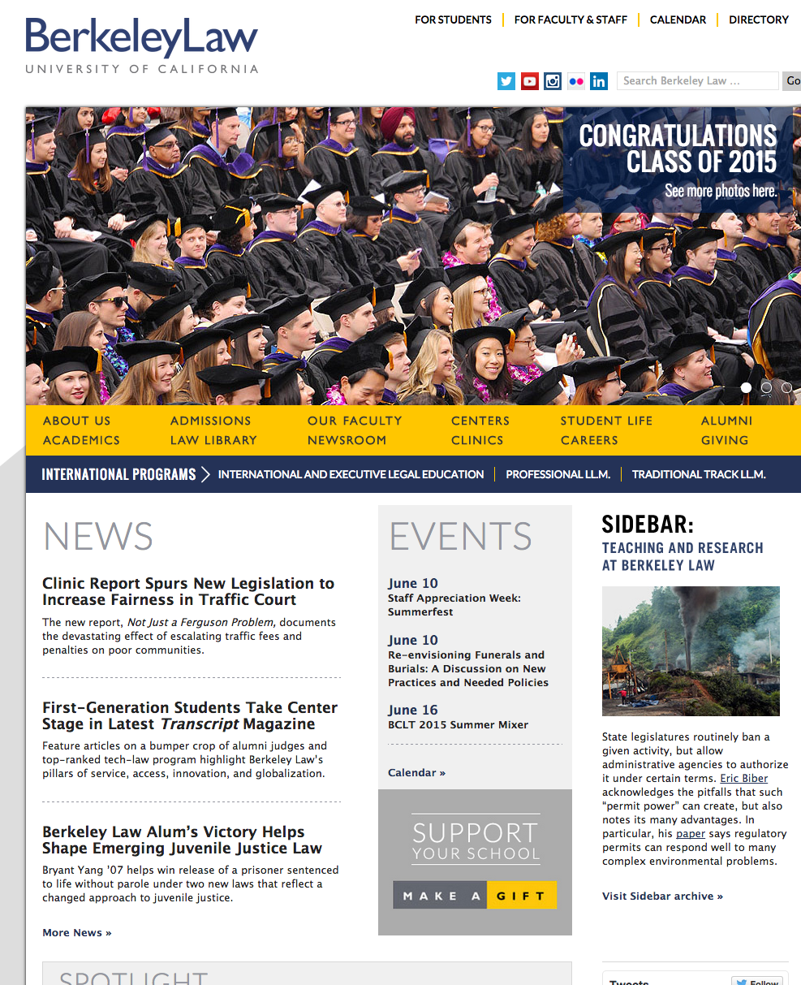
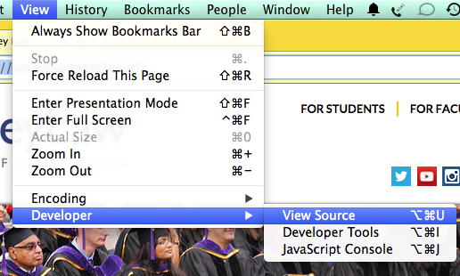
First, let's look at a website
Find and open Chrome.
(Spotlight: command-space)
Open Berkeley Law School:
http://www.law.berkeley.edu/
View source:
View ->developer ->View Source

Slide 3
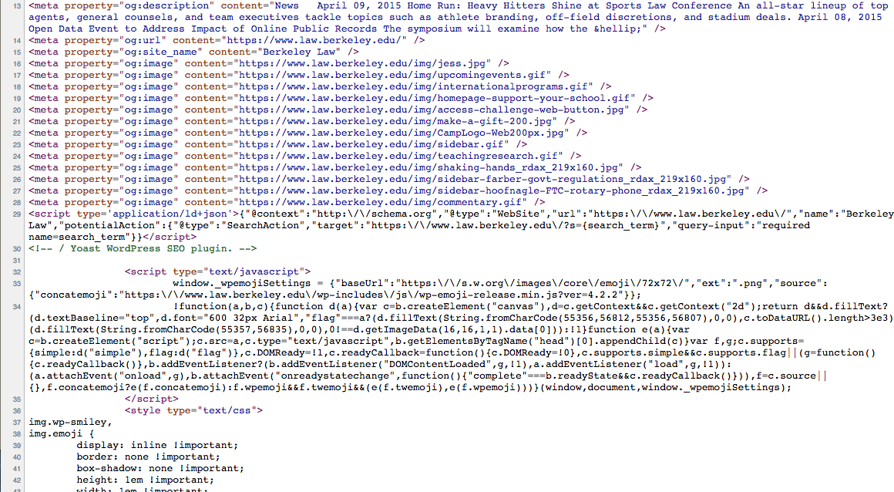
Ugh!

Slide 4
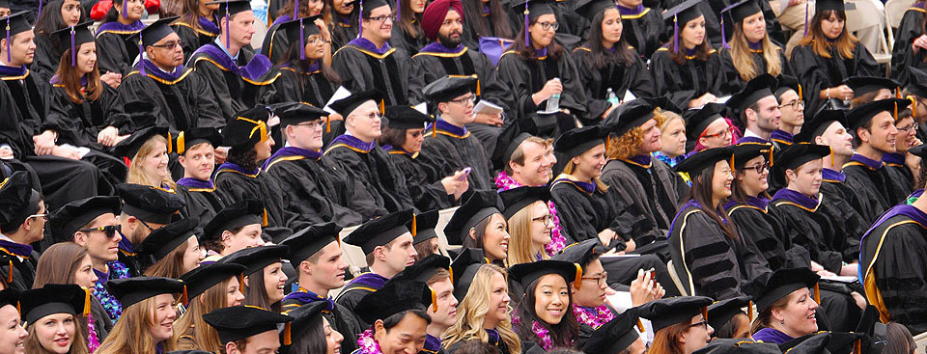

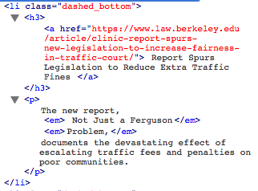
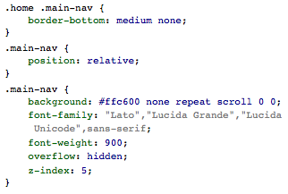
Four Types of Components
Assets
JavaScript
HTML
CSS

Slide 5
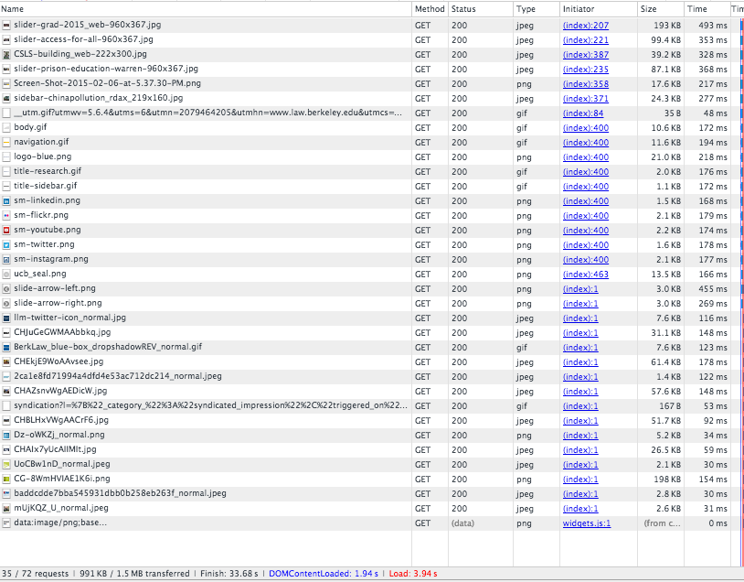
What happens when you load a page?
Answer: a lot!
35 pictures
73 total files

Slide 6
URLs
"Uniform Resource Locator"
https://www.law.berkeley.edu/wp-content/uploads/2015/04/slider-grad-2015_web-960x367.jpg
Protocol | https://
Subdomain | www.law.
Domain | berkeley.edu
Path | /wp-content/uploads/2015/04/
File | slider-grad-2015_web-960x367.jpg

Slide 7
Relative vs Absolute URLs
Fully-qualified | https://www.law.berkeley.edu/wp-content/uploads/2015/04/slider-grad-2015_web-960x367.jpg
Absolute | /wp-content/uploads/2015/04/slider-grad-2015_web-960x367.jpg
Local | slider-grad-2015_web-960x367.jpg
Down | ./uploads/2015/04/slider-grad-2015_web-960x367.jpg
up-then-down | ../../uploads/2015/04/slider-grad-2015_web-960x367.jpg

